Slide 1
IOT BASED SMART HOME SECURITY AND HOME AUTOMATION SYSTEM
PROJECT MEMBERS
SK.MD.MOHIDDIN BASHA - 20471A0247
SK. SHAHABAJ - 20471A0249
S.MAHESHWARI - 20471A0243
B.VENKATESH - 20471A0203
PROJECT GUIDE - Mr.SK.ABDUL KALAM M.Tech, (Ph.D)

Slide 2
ABSTRACT
Home automation has been gaining popularity as it provides the convenience of controlling home appliances from a remote location. This project proposes a home automation system using “NODEMCU8266” controlled through Google Voice Assistant. The NODEMCU8266 is a low-cost Wi-Fi-enabled microcontroller board that can be easily programmed using the “Arduino IDE”.
The system integrates “Google Voice Assistant” to control home appliances through voice commands, making it user-friendly and convenient. The proposed system includes a cloud-based platform that connects the NODEMCU8266 with the Google Voice Assistant. The system is designed to respond to voice commands in language and execute the corresponding actions.
The system can be easily customized to support additional home appliances and can be accessed remotely through the Internet. Overall, the proposed system offers a cost-effective and user-friendly solution for home automation. Index Terms - Home automation, NODEMCU8266, Google Voice Assistant, Wi-Fi, microcontroller, cloud-based platform

Slide 3
Introduction:
Just conceive that, how beneficial it will to be able switch on our air condition half hour before we reach our home on summer time. When we leave our home for some work without realizing that some appliances such as fans, air conditioners, and lights are on; then by using our mobile phone or internet, we are able to turn off power to those devices. It will be even more useful if the system detects unauthorized movement in the house and alerts us or sends messages on our mobile phones or we can know the status of our house anytime.
Such systems provide security from natural, incidental, intended, unintended, accidental and human made problems by continuously monitoring homes with different sensory systems like motion, smoke, gas, temperature, glass break or door break detectors and fire alarm systems. Security is a big challenge everywhere because thefts are increasing day by day owing to the unsafe and insecure security systems in homes, commercial complexes and industries. Several conventional technologies are available to keep home properties safe from intruders, but most common smart home security systems work on wireless GSM communication.

Slide 4
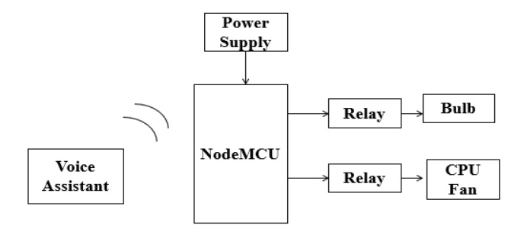
BLOCK DIAGRAM

Slide 5
Technology Used in Base Paper :
Internet of things
If This Then That(website)
Adafruit(It is a cloud server used to connect IoT devices through wifi and to display IOT project data online in real time)

Slide 6
Outcome of Existing Paper :
Implementation of home automation is been done wirelessly using bluetooth module in existing system
Commands are in the form of voice and this commands reaches to NODEMCU8266 microcontroller.
Manual work reduced to turn on\off the home appliances.
Bluetooth and RF Communication are have drawbacks that which control from 10 mts to 30mts long range

Slide 7
PROPOSED SYSTEM:
Send messages to user in case of emergencies like fire accident or gas leaking from home appliances.
Control lights and fans based on sensor data without voice commands.
Continous monitoring the home by camera.
Control the water pump on/off according to water level sensor data in water tank.
Monitor temperature,humidity, and create more efficient and automated environment.

Slide 8
ABSTRACT AFTER EXTENSION:
Home security based on Internet of Things (IoT) is getting huge attention of mass people in recent years. Smart home eases and secures the management of the home appliances. This project main aim is a low cost and reliable smart home system that assists the users to manage home appliances without the need of their physical presence.
It can store and display information of temperature & humidity of a home, and notifies the users of switching on/off time of light, fan and other home appliances using IoT platform. The system includes gas leakage & fire alarm. It has leakage gas removing & fire extinguishing facility and notification system using IoT platform.
The system uses real IP and RESTful API for controlling, monitoring and accessing the home appliances remotely from anywhere in the world using Android based smartphone app or web app. This system is user friendly and energy efficient.

Slide 9
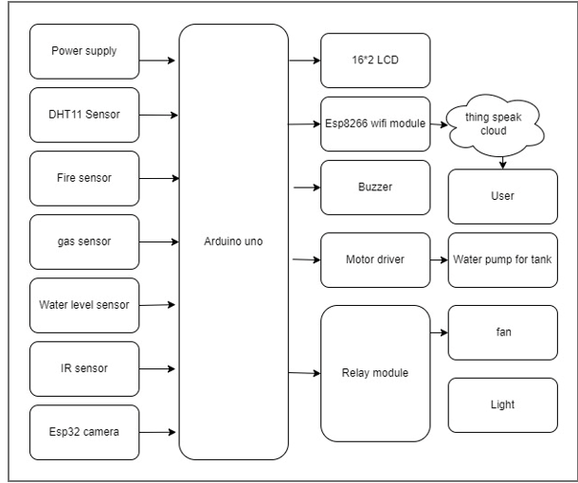
PROPOSED BLOCK DIAGRAM:

Slide 10
Hardware and software components used:
Arduino uno
Fire sensor
Gas sensor
Temperature sensor
Buzzer
16*2 LCD
Esp32 camera
Water level sensor
Esp8266 WIFI Module
Relay modules ,cpu fan,bulb holder etc
Arduino Software
Arduino C Language
Thing speak cloud

Slide 11
Advantages:
Energy Savings. Home automation systems have definitely proven themselves in the arena of energy efficiency. ...
Convenience. In today's fast-paced society, the less you have to worry about, the better. ...
Security. ...
Installation. ...
Complex Technology. ...
System Compatibility. ...
Cost.

Slide 12
Future scope:
The future scope of home security lies in advanced technologies such as artificial intelligence, facial recognition, and smart sensors, making homes safer and more responsive to potential threats. Similarly, home automation is set to expand with increased integration of smart devices, allowing for seamless control of lighting, heating, and appliances through voice commands and mobile applications, enhancing convenience and energy efficiency in households

Slide 13
THANK YOU

